Slide 1
Network Analysis using R
Bomi Lee

Slide 2
Outline
Basics
Visualizing networks
Centralities
If you are interested in network analysis…
POLI:7002:0001 | Topics Methodology: Networks

Slide 3
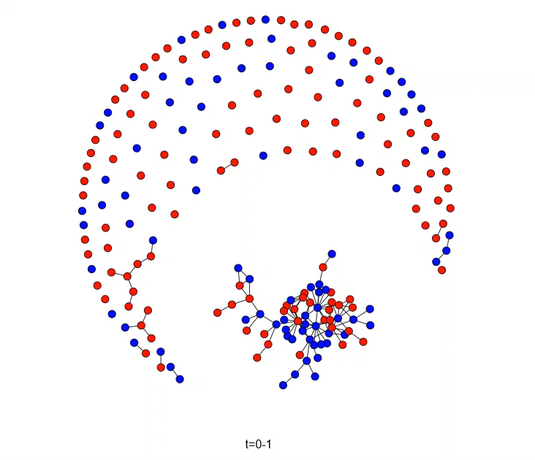
Changes of Rivalries from 1968 to 2003
5-year intervals

Slide 4
Research Design
Network as IV
Network as DV
Friendship -> Behavior
Centrality -> Promotion
Homophily -> Friendship
Personality -> central actors

Slide 5
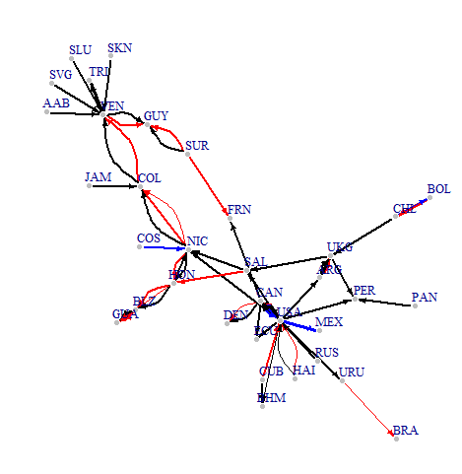

Slide 6
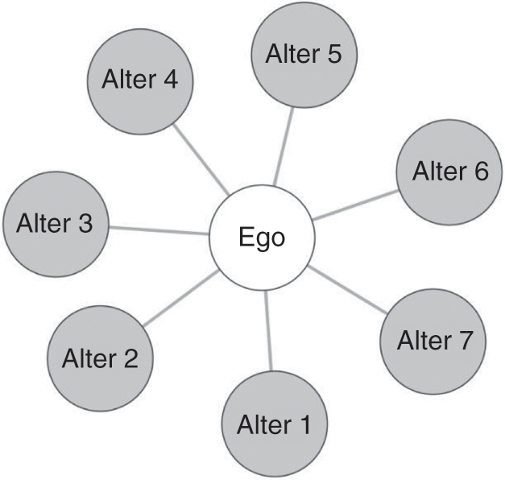
Terms
A network is a collection of nodes joined by edges
Whole network
Complete universe of cases
Sample Networks
Ego-net
Questions to ask if ego net
Who is the ego?
How many steps removed are you going from the ego?
(think 6 degrees of Kevin Bacon)
Respondent-driven sample
Some combination of the two (multiple ego nets, etc)

Slide 7
Terms
Node- unit we are examining
Could be countries, people, cities, etc.
Synonyms: Vertex, Sites, Actors
Tie- connection between two nodes
Directed or undirected?
Example directed: giving money to a person
Example undirected: friendship, conversation
Binary or Valued?
Do you only care if a tie exists?
Do you care about the nature of the tie?
Synonyms: Edge, Link, Bond

Slide 8
Relationship?

Slide 10
Data: Adjacency Matrix vs Edge list
Adjacency Matrix- values show connection between nodes
Often omit 0, just care about 1 if binary

Slide 11
Edge list
2 columns- node 1, node 2
Sometimes 3rd column for weight if not binary
Missing edges not included (usually)

Slide 12
R – Visualizing networks

Slide 13
Centrality
What does it mean for an actor to be central?

Slide 14
Centralities
Degree
In-degree
Out-degree
Eigenvector
If one’s alters have high degree centrality, then the focal actor has high eigenvector centrality.

Slide 15
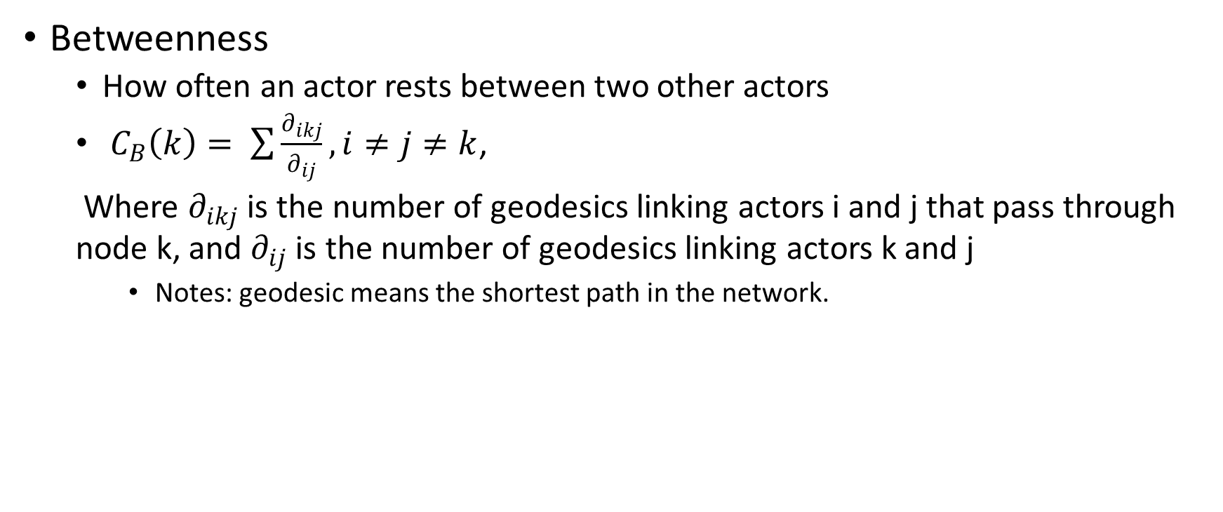
Centralities
Betweenness
How often an actor rests between two other actors
$C_{B}\left(k\right)= \sum{\frac{∂_{ikj}}{∂_{ij}}, i≠j≠k}$,
Where $∂_{ikj}$ is the number of geodesics linking actors i and j that pass through node k, and $∂_{ij}$ is the number of geodesics linking actors k and j
Notes: geodesic means the shortest path in the network.

Slide 16
Centralities
Closeness
emphasizes an actor’s independence.
If an actor is not central, the actor generally needs to rely on others to relay messages through the network. Thus, an actor who is close to many other actors is a very independent actor.

Slide 17
R – Centralities

Slide 18
R – Centralities

Slide 20
Dyads
Reciprocity

